Slide 1
2023 2002
Max of Year Min of Year
31
Count of Day
Power BI Desktop
Qtr 1
First Quarter
April
First Month
40K
2K
30K
20K
Count of ID
Count of ID
1K
10K
0K
0
10
20
30
0K
2000
2010
2020
Day
Year
20K
20K
15K
15K
Count of ID
10K
Count of ID
10K
5K
5K
0K
January
February
March
April
May
June
July
August
October
November
December
September
0K
Qtr 1
Qtr 2
Qtr 3
Qtr 4
Month
Quarter

Slide 2
no of crimes by Year
Power BI Desktop
40K
30K
20K
10K
0K
no of crimes
2020
2021
2022
2023
no of crimes by Quarter
20K
no of crimes by Month
20K
Year
no of crimes by Day
18.3K
19.4K
19.3K
2000
2066
18.0K
15K
1636
15K
1500
no of crimes
no of crimes
10K
no of crimes
1314
10K
1080
1000
860
5K
823
773
5K
500
0.3K
0.8K
1.2K
0.1K 0.1K 0.1K 0.1K 0.1K 0.2K
0.1K
0.4K
0K
78
0.3K
January
February
March
April
May
June
July
August
October
December
0K
September
November
0
Qtr 1
Qtr 2
Qtr 3
Qtr 4
0
10
20
30
Quarter
Month
Day

Slide 3








Count of Block by Arrest
Count of Arrest by District
Power BI Desktop
Count of Arrest by Community Area
Count of Arrest by Ward
3K
2,000
2,000
30K
Count of Arrest
Count of Arrest
1,500
Count of Arrest
1,500
Count of Block
2K
20K
1,000
1,000
1K
10K
500
500
0K
0
20
40
0
0
50
0
0
50
0K
False
Arrest
True
District
Community Area
Ward
Count of Arrest by Beat
Count of Arrest by Case Number
Count of Arrest by Domestic
3
400
30K
Count of Arrest
2
Count of Arrest
Count of Arrest
20K
1
200
10K
0
JG499426
JF528120 JG446325 JG453003 HH588032 HK152630 HK290834
HK295272
HK298461 HL100005 HL204951 HL219455 HL223100 HL225517 HL231135 HL268834
0
0
1000
2000
3000
0K
False
True
Beat
Case Number
Domestic

Slide 4
no of crimes by Domestic
no of crimes by FBI Code
Count of Arrest by FBI Code
FBI Code
Power BI Desktop
FBI Code
0K
1K (2.98%)^{(0.66%)}
1K (3.18%)
1K (3.38%)
2K (4.79%)
6
08B
14
7
08A
01A
01B
04A
04B
08A
7K (17.69%)
9K (21.65%)
Domestic
False
2K (5.66%)
26
08B
10
11
12
13
14
15
16
17
18
19
2
20
22
24
26
3
True
3
11
04B
15
6K
(13.98%)
3K (6.32%)
33K (82.31%)
3K (7.34%)
4K (10.65%)
0.08K
_{8.5…}(0.21%)
(2…)
0.12K
(0.31%)
5.…
(…)
4K (11.11%)
no of crimes by IUCR
no of crimes by IUCR
1.1… (2.…)
4.4K
(11.1…)
0.76K
810
820
486
910
1320
460
560
1310
860
810
820
486
910
1320
460
560
1310
860
(1.92%)
IUCR
IUCR
0K
2K
no of crimes
4K
0
500
1000
1500 2000
no of crimes
2500
3000
3500

Slide 5
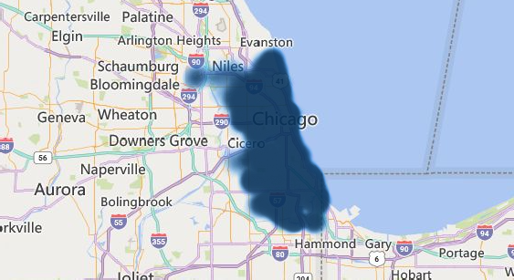
39.64K
Count of Arrest
40K
no of crimes
Power BI Desktop
1M
Sum of Community Area
452K
Sum of District
39.64K
Count of ID
Primary Type
ARSON
ASSAULT
BATTERY
BURGLA…
CONCE…
CRIMIN…
CRIMIN…
CRIMIN…
3K
no of crimes
2K
1K
0K
12:00 AM
3:00 AM
6:00 AM
9:00 AM
12:00 PM
CRIME HOUR
3:00 PM
6:00 PM
9:00 PM
© 2024 Miiccrrossofftt Corrporrattiion
20K
no of crimes
2020
10K
Year
2010
0K
January
February
March
April
May
June
July
August
Septem…
October
November
December
2000
0K
10K
20K
no of crimes
30K
40K
Month

Slide 6

no of crimes by Arrest
100%
Power BI Desktop
no of crimes by Location Description
STREET APARTMENT RESIDENCE SIDEWALK
PARKING LOT / GARAGE… SMALL RETAIL STORE
ALLEY RESTAURANT
11.8K
Location Description
7.2K
4.7K
False
35K
1.4K
1.1K
1.0K
0.8K
2.3K
5K
True
0K
5K
10K
14.3%
no of crimes by Description
SIMPLE OVER $500
$500 AND UNDER DOMESTIC BATTERY SIMPLE
AUTOMOBILE TO VEHICLE TO PROPERTY RETAIL THEFT
ARMED - HANDGUN AGGRAVATED - HANDGUN ATTEMPT - AUTOMOBILE
FROM BUILDING UNLAWFUL POSSESSION - HANDGUN
FORCIBLE ENTRY
4.7K
2.9K
2.8K
2.8K
3.1K
Description
2.6K
1.8K
1.1K
1.1K
0.9K
0.8K
0.7K
0.7K
1K
1.4K
0K
2K
3K
4K
5K

Slide 7



917K
Sum of Ward
Power BI Desktop
39.64K
Count of Arrest
452K
Sum of District
1M
Sum of Community Area
39.64K
Count of ID
no of crimes by Ward
no of crimes by District
no of crimes by Community Area
Ward
27
28
6
17
24
8
20
9
16
4
7
42
21
37
District
8
6
12
4
11
25
1
19
18
3
2
9
7
10
5
Community Area
25
8
28
32
43
24
23
71
29
69
6
44
49
66
0K
0K (1.13%)^{(0.97%)}
0K (1.2…)
1K (1.…)
1K (1…)
1K (1.44%) 1K (1…)
1K (1.…)
1K (1.…)
1K (1.7…)
1K (1.87%)
1K (2.51%)
1K
1K (3.1%) ^{(3%)}
1K (3.59%)
1K (3.6%)
1K (3.7%)
2K (3.…)
2K (4.05%)
2K (4.12%)
2K (4.59%)
2K (4.82%)
1K (2.25%)
3K (6.92%)
2K (6.02%)
2K
(5.98%)
2K
(5.81%)
2K (4.5%)
1K (3.75%)
1K (3.3…)
1K
(3.33%)
1K
(3.19%)
1K (3…)
1K (3.…)
1K (3.…)
1K (3%)
1K (2.77%)
0K (0.28%)
2K (4.59%)
2K (3.…)
1K
(3.05%)
0K (0.…)
0K (0…)
0K (…)
2K
(5.56%)
1K (…)
1K (…)
1K (1.…)
1K (1.88%)
1K
(2.56%)
1K (2.…)
1K (1.93%)
2K
(5.51%)
2K (5.31%)
3 | 2K (4.98%) | 2K (5.27%) | 22
34 |  | 16 | 19
10 |  | 24 | 67
5 |  | 14 | 3
29 |  | 17 | 68

Slide 8

no of crimes by Primary Type
Power BI Desktop
THEFT
BATTERY
CRIMINAL DAMAGE
ASSAULT
ROBBERY
WEAPONS …
BURGLARY
NARCOTICS OFF…
CRI…
MOTOR VEHICLE THEFT
DECEPTIVE PRACTICE
OTHER OFFENSE
SEX …
CRIMINAL…
no of crimes by Primary Type
no of crimes by Primary Type
Primary Type
THEFT
BATTERY
CRIMINAL DAMAGE MOTOR VEHICLE THEFT
ASSAULT
OTHER OFFENSE ROBBERY
DECEPTIVE PRACTICE WEAPONS VIOLATION BURGLARY NARCOTICS CRIMINAL TRESPASS
OFFENSE INVOLVING CHI…
0K
1K (1.92%)^{(0.67%)}
1K (3.11%)
2K (5.48%)
2K (5.66%)
4K (12.81%)
9K (31.17%)
9K (21.65%)
4K (15.34%)
Primary Type
THEFT
BATTERY
CRIMINAL DAMAGE MOTOR VEHICLE THEFT ASSAULT
2K (5.78%)
4K (8.9%)
7K
(17.14%)
4K (16%)
7K (24.68%)
4K (10.65%)
4K (11.11%)

Slide 9
no of crimes by District and Primary Type
Primary Type ARSON ASSAULT BATTERY BURGLARY
3K
Power BI Desktop
no of crimes by District and Primary Type
Primary Type ARSON ASSAULT BATTERY BURGLA…
CONCEALED…
CRIMINAL …
CONCE…
CRIMIN…
CRIMIN…
3K
3K
2K
2K
0.5K
2K
2K
no of crimes
2K
no of crimes
2K
0.4K
0.4K
0.6K
0.4K
0.3K
0.4K
0.3K
0.4K
1K
1K
0.3K
0.5K
0.3K
 | 0.5K
 |  |  | 0.3K
0.4K
0K
0K
0.3K
0 5 10 15
20
25
30
35
4
6
8
District
10
12
District
no of crimes by District and Primary Type
Primary Type ASSAULT BATTERY CRIMINAL DAMAGE
2000
MOTOR VEHICLE THEFT
THEFT
1500
no of crimes
1000
500
0
0
5
10
15
20
25
30
35
District

Slide 10
no of crimes by Ward and Primary Type
Primary Type ARSON ASSAULT BATTERY
2000
no of crimes by Ward and Primary Type
Primary Type ARSON ASSAULT BATTERY
Power BI Desktop
BURGLARY
CONCEALED …
CRIMINA…
BURGLARY CONCEA… CRIMIN… CRIMIN…
1500
1429
1500
1302
no of crimes
no of crimes
1146
1000
932
964
1000
714
702
619
433
549
445
403
500
500
231
285
266
157
89
₄ 47
160
70
0
0
1
0
10
20
30
40
50
0
10
20
Ward
30
40
Ward
no of crimes by Ward and Primary Type
Primary Type ASSAULT BATTERY CRIMINAL DAMAGE MOTOR VEHICLE THEFT THEFT
1000
no of crimes
500
0
0
10
20
30
40
50
Ward

Slide 11
no of crimes by Domestic
no of crimes by Domestic and Primary Type
Power BI Desktop
0K (0.13%)
3K (8.75%)
1K (2.41%)
1K (3.09%)
0K (0.19%)
3K (8.39%)
False
1K (2.84%)
Domestic
Domestic
False
4K (9.67%)
True
0K (0.58%)
True
8K (20.73%)
2K (5.41%)
0K (0.02%)
4K (10.52%)
0K (0.01%)
0K
20K
no of crimes
40K
1K (3.52%)
no of crimes by Domestic and Description
Description $500 AN… ABUSE / … AGG. DO… AGG. PR…
AGGRAV…
AGGRAV…
AGGRAV…
AGGRAV…
AGGRAV…
AGGRAV…
AGGRAV…
AGGRAV…
AGGRAV…
AGGRAV…
AGGRAV…
AGGRAV…
Domestic
False
True
2.7K
0.9K
0.3K
0.4K
0.2K
1.1K
0.9K
8K
0.2K |  | 0.2K
1K
0K 1K
no of crimes by Domestic and Description
2K
3K
4K
no of crimes
5K
6K
7K
Description $500 AND UNDER AUTOMOBILE DOMESTIC BATTERY SIMPLE
OVER $500
SIMPLE
Domestic
False
True
2.7K | 2.7K | 3.0K | 3.9K
12K
2.8K
0.8K
4K
0K
2K
4K
6K
no of crimes
8K
10K
12K

Slide 12
no of crimes by Month
20K
no of crimes by Month
Power BI Desktop
Count of Description by Month
0K (0.23%)
Date Month
1K (3%)
January
February March April May
116 (16.07%)
87 (12.05%)
no of crimes
15K
104
(14.4%)
Date Month
July
August September
10K
5K
June
October November
0K
18K (45.59%)
July
August
207
(28.67%)
March
April
May
June
July
January
August
October
February
December
September
November
18K (46.3%)
Month
208 (28.81%)
no of crimes by Month and Primary Type
Primary Type ARSON ASSAULT BATTERY BURGLARY CONCE… CRIMIN… CRIMIN… CRIMIN…
20K
Count of Primary Type by Month
24 (17.65%)
18 (13.24%)
15K
18
(13.24%)
Date Month
April
July August September October November
no of crimes
10K
5K
28
(20.59%)
21
(15.44%)
0K
January
February
March
April
May
June
July
August
September
October
November
December
27 (19.85%)
Month

Slide 13
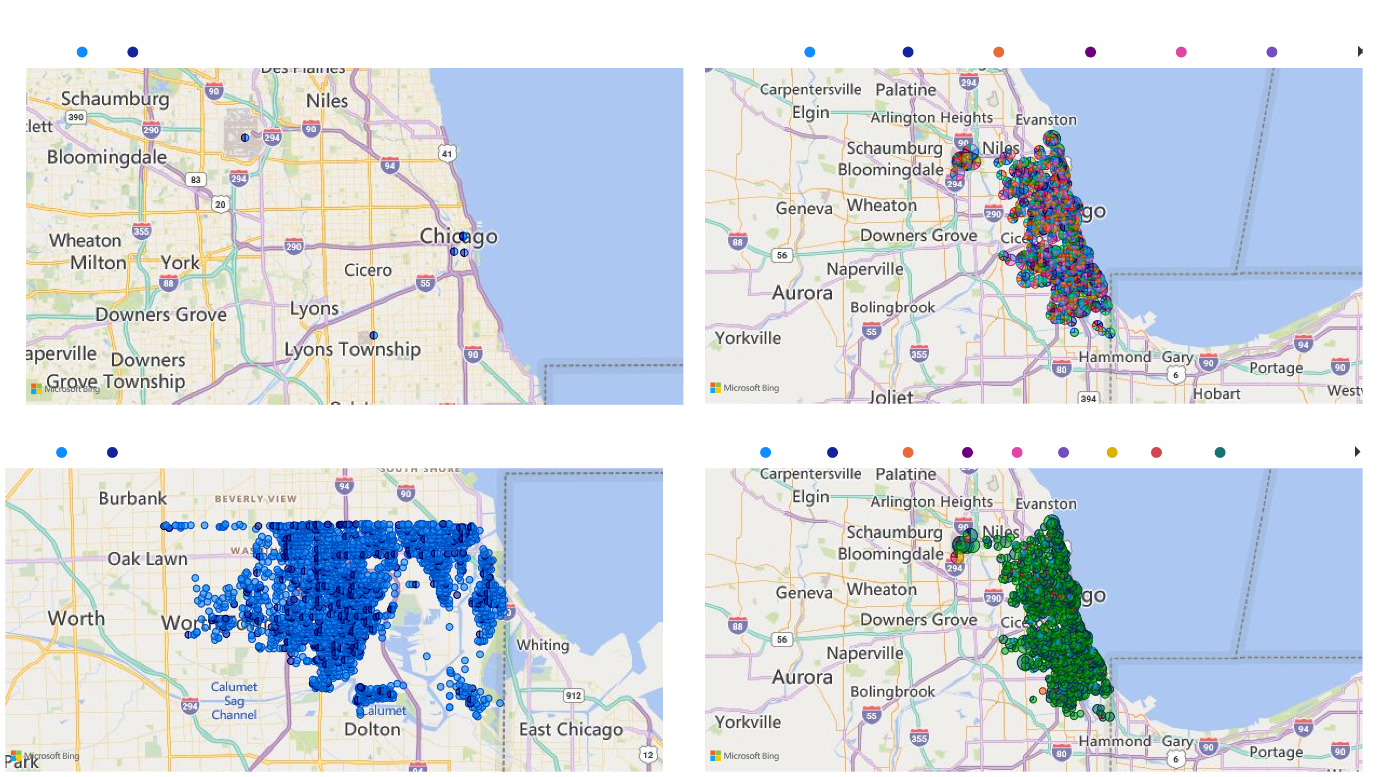
lat and long by Location and Arrest
Arrest False True
Power BI Desktop
lat, long and no of crimes by Location and CRIME HOUR
CRIME HOUR 12:00:00 AM 1:00:00 AM 2:00:00 AM 3:00:00 AM
4:00:00 AM
5:00:00 AM
© 2024 Miiccrrossofftt Corrporrattiion
© 2024 Miiccrrossofftt Corrporrattiion
lat and long by Location and Arrest
Arrest False True
lat, long and no of crimes by Location and Month
Month January February March April May June
July
August
September
© 2024 Miiccrrossofftt Corrporrattiion
© 2024 Miiccrrossofftt Corrporrattiion

Slide 14
Count of Arrest by Year
Power BI Desktop
40K
30K
20K
10K
0K
Count of Arrest
2014
2016
2018
2020
2022
Count of Arrest by Quarter
20K
Count of Arrest by Month
20K
Year
Count of Arrest by Day
18.3K
19.4K
19.3K
2,000
2066
18.0K
15K
1636
15K
Count of Arrest
1,500
Count of Arrest
Count of Arrest
10K
1080
1314
10K
1,000
860
5K
823
773
5K
500
0.3K
0.8K
1.2K
0.1K 0.1K 0.1K 0.1K 0.1K 0.2K
0.1K
0.4K
0K
78
0.3K
January
February
March
April
May
June
July
August
October
December
0K
September
November
0
Qtr 1
Qtr 2
Qtr 3
Qtr 4
0
10
20
30
Quarter
Month
Day

Slide 15
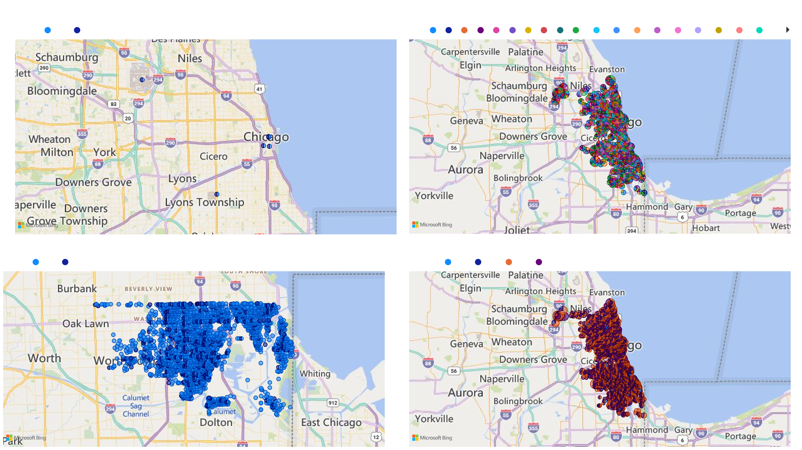
lat and long by Location and Arrest
Arrest False True
Power BI Desktop
lat, long and no of crimes by Location and Day
Day 1 2 3 4 5 6 7 8 9 10 11 12
13 14 15 16 17 18 19
© 2024 Miiccrrossofftt Corrporrattiion
© 2024 Miiccrrossofftt Corrporrattiion
lat and long by Location and Arrest
Arrest False True
lat, long and no of crimes by Location and Quarter
Quarter Qtr 1 Qtr 2 Qtr 3 Qtr 4
© 2024 Miiccrrossofftt Corrporrattiion
© 2024 Miiccrrossofftt Corrporrattiion

Slide 16
Count of ID by Primary Type
Count of ID by Primary Type
Primary Type
Power BI Desktop
0.3K (0.76%)
1.18K (2.98%)
2.17K (5.48%)
2.25K (5.66%)
THEFT
BATTERY
CRIMINAL DAMAGE MOTOR VEHICLE T…
ASSAULT
2.25K (7%)
2.29K (7.14%)
8.58K (21.65%)
Primary Type
THEFT
BATTERY
CRIMINAL DAMAGE
8.58K (26.76%)
3.53K (11%)
OTHER OFFENSE ROBBERY
DECEPTIVE PRACTICE WEAPONS VIOLATI… BURGLARY
MOTOR VEHICLE THEFT ASSAULT
OTHER OFFENSE
2.29K (5.78%)
6.79K
(17.14%)
4.22K (13.17%)
3.53K (8.9%)
4.22K (10.65%)
6.79K (21.19%)
ROBBERY
4.4K (11.11%)
4.4K (13.74%)
Count of ID by Description
Count of ID by Description
Description
SIMPLE
OVER $500
$500 AND UNDER DOMESTIC BATTERY SIMPLE
AUTOMOBILE TO VEHICLE TO PROPERTY RETAIL THEFT
ARMED - HANDGUN AGGRAVATED - HANDGUN
ATTEMPT - AUTOMOBILE FROM BUILDING
0.01K
0.06K (0.14%)(0.03%)
0.1K (0.24%)
0.15K (0.39%)
0.2K (0.51%)
0.29K (0.74%)
0.36K (0.9%)
0.36K (0.9%)
0.39K (0.9…)
0.4K (1%)
0.52K (1.31%)
0.7K (1.77%)
0.92K (2.33%)
1.12K (2.83%)
1.8K (4.54%)
1.8K (8.66%)
4.69K (11.83%)
2.58K (12.42%)
4.69K (22.59%)
Description
SIMPLE
OVER $500
$500 AND UNDER DOMESTIC BATTERY SI… AUTOMOBILE
TO VEHICLE TO PROPERTY
3.14K (7.91%)
2.93K
(7.38%)
2.79K (13.44%)
3.14K
(15.1%)
2.84K (7.17%)
2.84K (13.69%)
2.79K (7.04%)
2.93K (14.1%)
2.58K (6.5%)

